Slide 1
Bike Sharing in Mexico City
Final Project Introduction to Data Science
Jesus L. Trujillo
October 2014

Slide 2
The project
Bike sharing system information from Mexico City ‘Ecobici’: http://datos.labplc.mx/datasets/view/ecobici
The program started in February of 2010 and is considered one of the most successful in the world:
http://www.economist.com/node/16591116

Slide 3
What do we know about bikes?
To model this problem I followed the Kaggle competition structure:
Predict demand of bikes using weather data and characteristics of users
Data already processed but offered little insights on what else is going with bike data

Slide 4
Process
Bike usage data
3 different files:
-User
-Trips
-Stations
Data Acquisition
-Almost 1 gigabyte
365 different ‘files’:
-Web scrapping process to gather all of the data
Mexico City Weather Data

Slide 5
Two main objectives
Descriptive statistics:
Number of trips
Average duration and distance traveled
Hourly, Daily and Monthly usage etc.
Predictive modeling:
Boosted Regression Model
Bayesian Ridge Regression
Support Vector Machine Regression

Slide 6
Descriptive statistics
In 2012 there were 2,874,749 travels, or almost 8,000 trips a day
The average duration of a trip is: 14.8 minutes
And the average distance traveled per trip is: 1.13 km.

Slide 7
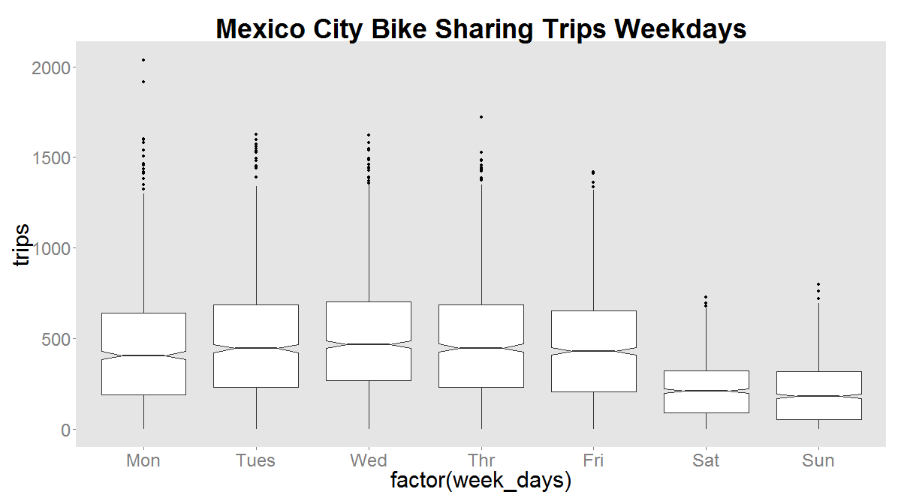
Usage by Day of the Week

Slide 8
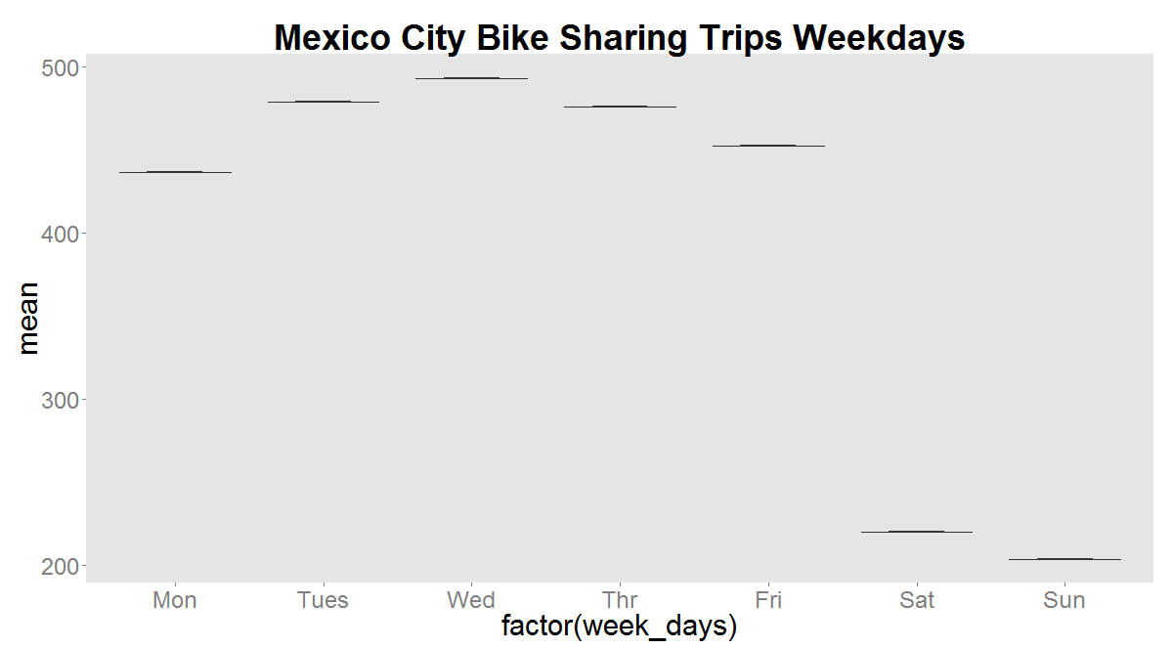
A more accurate description of usage by day of the week

Slide 9
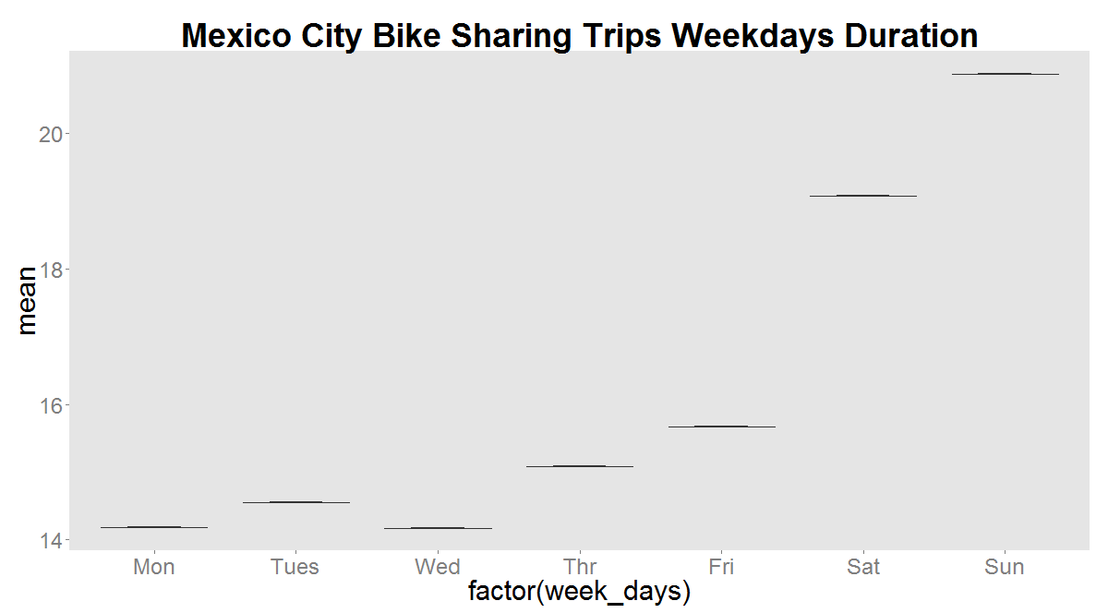
But if time matters…

Slide 10
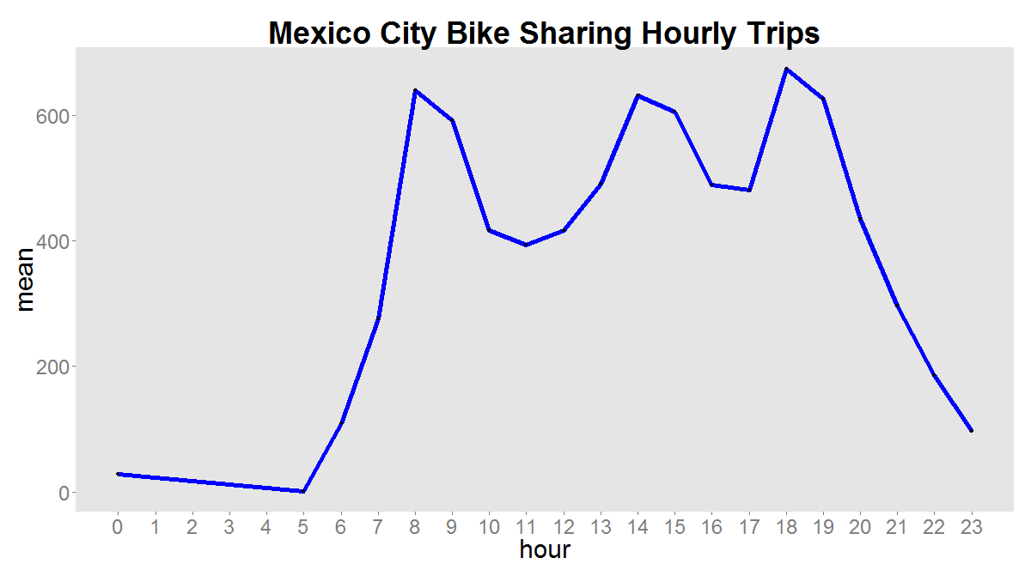
What about hourly?

Slide 11
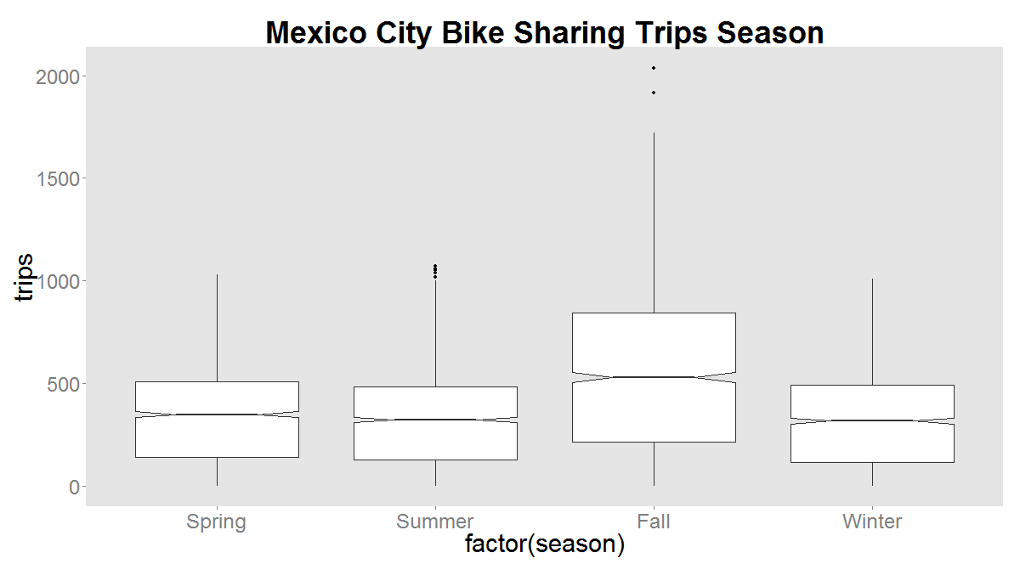
What about seasons?

Slide 12
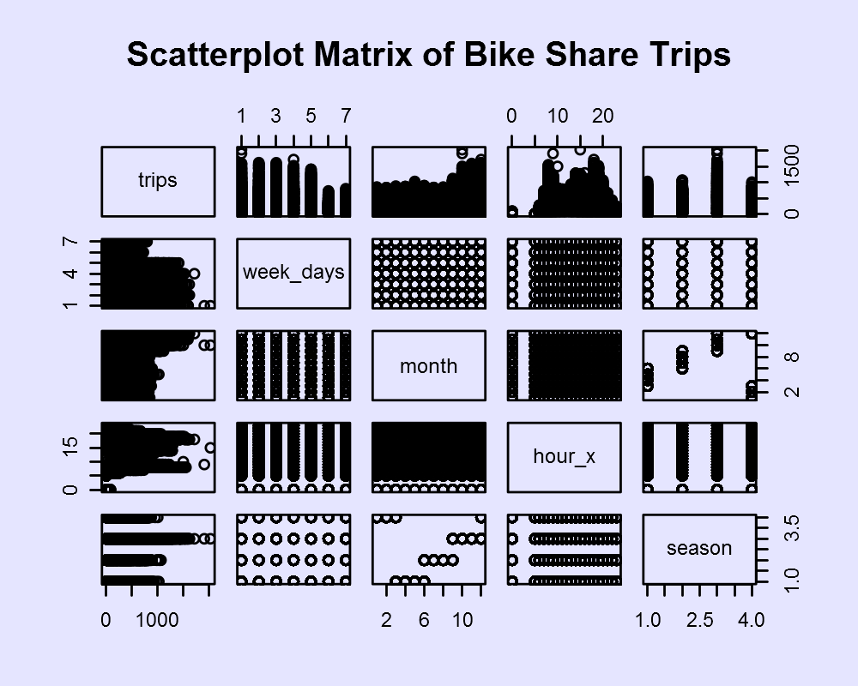

Slide 13
Predicting Bike Demand
After transforming the data I ended up with a data frame composed of 7,320 observations and 13 predictors (X) and a target (Y):
The predictors are:
week_days, month, hour, season, Gust Speed, Humidity, WindirDegrees, Conditions, Events, Dew Point, TemperatureF, VisibilityMPH, and WindSpeed
The target variable is:
Number of trips in a given hour

Slide 14

The Kaggle Method
Accuracy is evaluated using the Root Mean Squared Logarithmic Error (RMSLE).
n is the number of observations in the test set
pi is your predicted count
ai is the actual count
log(x) is the natural logarithm

Slide 15
Boosted Regression Model
First step in the model was to normalize the data and make sure that there were no missing values:
Scikit Learn really does not like NaN
The first model specifications (default) gave a pretty mediocre prediction rate:
10.4313000472
Actual benchmark: 0.24976
Optimized model gives:
6.34154256614

Slide 16
Bayessian Ridge Regression
Did a better job predicting in variation:
Predicted values ranged from 0 to 987
Max value in my dataset is 1687
The R squared was a bit better although I could not really improve accuracy at all:
rmse=6.4

Slide 17
Support Vector Machine Regression.
This was the model with the highest success rate:
rsme= 6.29587856774
Did better with data variation than Gradient boosting regression.

Slide 18
Next steps
Add more variables to the dataset:
If the weekday is a holiday
Better temperature data
Pay day
Better transformation of the categorical variables:
Many of the numeric values are meaningless
Understand a bit better what is going in the blackbox
Find clean curated data!

